Slide 1
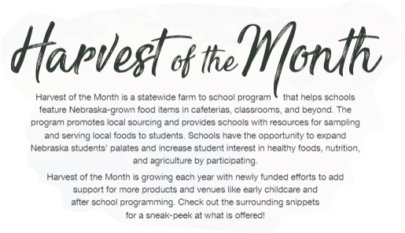
Turnips are the featured item this month
Visit the Nebraska Department of Education, Harvest of the Month website here.
Notes:
Communications toolkit, Materials/ideas for engaging students, taste tests & recipe guides

Slide 2
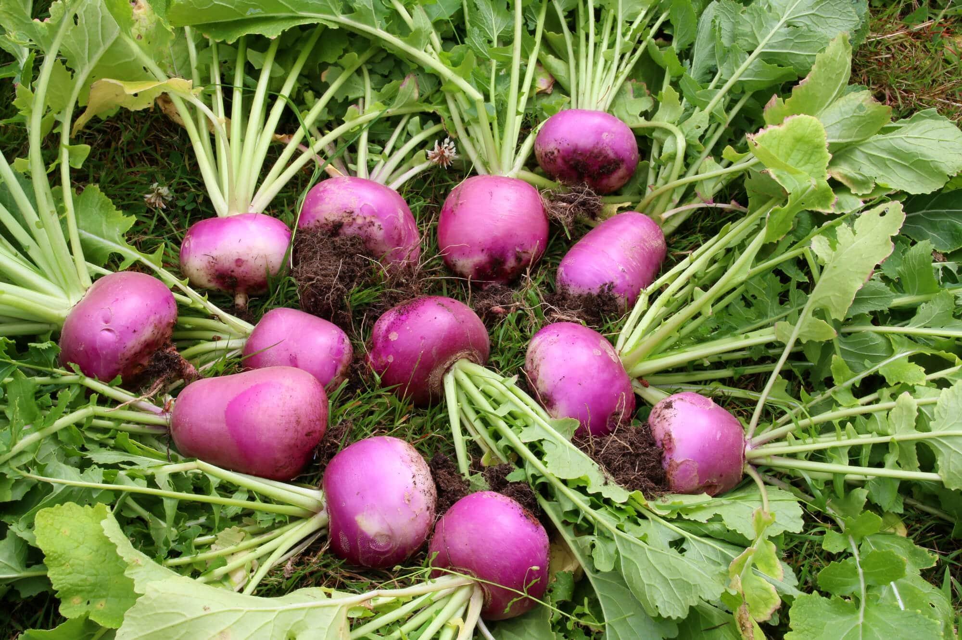
~Turnips~
Historical Tidbit -
Original Halloween jack-o'-lanterns came from Ireland and were made out of turnips.
Aronia berries are only in season August and September, but can be preserved and purchased in many forms, from powder and frozen to juice and jelly.
Fun Fact:
Turnip flowers are able to perform
Self-pollination in the case that pollinators are not available. It is also a biennial plant, which means it completes its life cycle in two years.
Have you had turnips with a meal before?
A half a cup of turnip greens provides
an excellent source of Vitamins A, C,
and K, and a good source of folate.
Did You Know - Baby turnips can be harvested young and
eaten raw.

Slide 3
Notes:
Answer: A

Slide 4
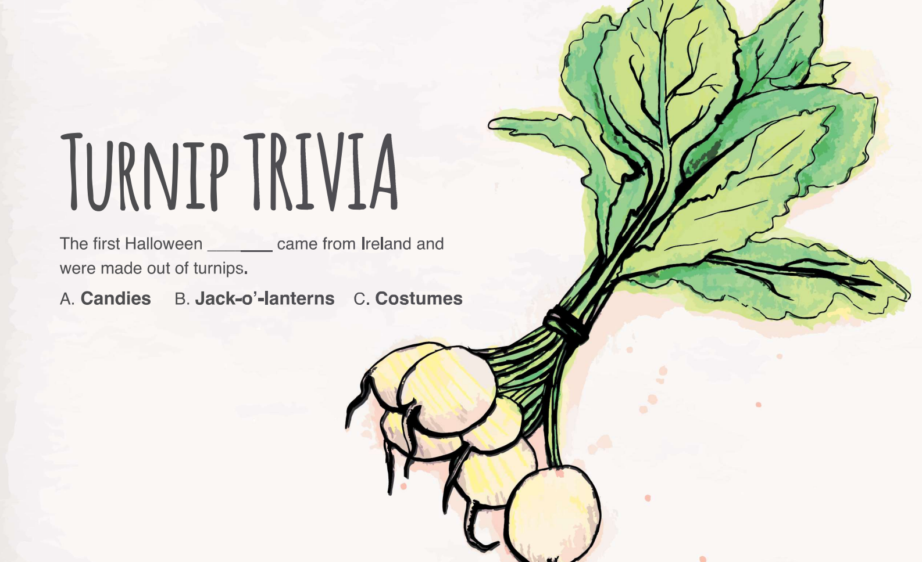
Notes:
Answer: B

Slide 5
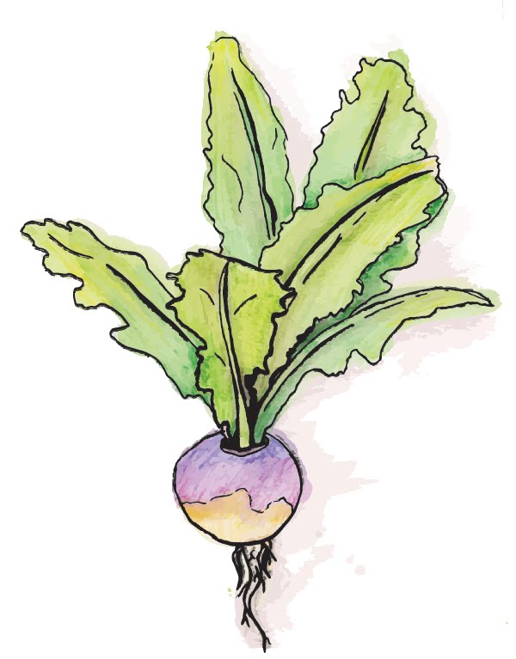
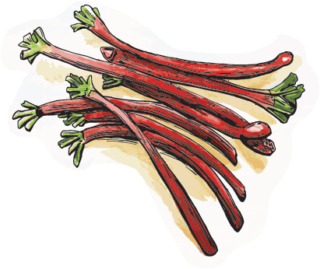
Welcome to the Chef’s Table
Let’s Find out what YOU like!
Step 1 - Evaluate
Sensory evaluation: Take a few minutes to see, smell, feel, and taste the recipe. Record your observations.
Marketing evaluation: Provide thoughts on the recipe’s marketability. Develop a creative name and full menu with complementary pairings.
Supporting a Nebraska farm to school project!
Your input will fuel a larger project to serve more recipes using local foods that are appealing to students to school meals.
What’s a Chef’s Table?
An immersive tasting event that allows for an up-close and personal experience with a recipe. Adapted for schools to incorporate student perspectives of recipes being considered in the school meal program.
Step 2 - Share
Regroup to discuss observations & ideas.
Farm to school efforts build the connection between local producers & schools which helps our local farmers and provides fresher, tastier foods to YOU at school.
Notes:
Traditionally, Chef’s Tables were so named because they allowed restaurant-goers sitting at the table to see the chef’s culinary processes in action. Adapted for the school setting to engage youth and school staff outside of the cafeteria environment. Through this new iteration, the School Chef’s Table puts youth at the center of the taste testing experience and incorporates their perspective for being considered in the school meal program.
Creates excitement for new menu items available through the school meal program!
Marketing eval: assist with developing a fun and creative name for the recipe, how to menu the recipe on the school meal menu using existing complementary options (fruit, vegetable, grain, etc.)

Slide 6
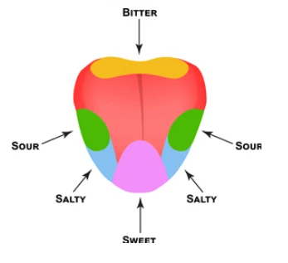
To keep students healthy, schools are required to offer 5 components at lunchtime:
Bread/grain
Meat/protein
Fruit
Vegetable
Milk
What meal did you build?
How did it go?
Different taste buds recognize different flavors: salty, sweet, sour, bitter, & savory.
What did you like about the recipe?
Would you change anything?
Had you tried it before?
Would you eat it again?
It can take 10 times of tasting a new food before you know whether you really like it and taste buds change over time, so keep trying!
What recipe name did you choose?

Slide 7
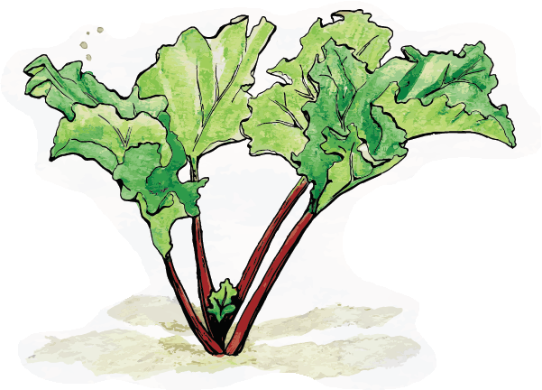
THANKS FOR PARTICIPATING!!!!
Notes:
Your results will be shared with the food service staff & chef who developed the recipe!

Slide 8
Chef’s Table
Marketing & Promoting ideas!
Step 1 - Promoting Apples
Encouraging youth to eat the featured apples recipe: What Fun recipe name did you come up with (link in naming doc here) to encourage your peers to eat this item?
Marketing evaluation: Provide thoughts on the recipe’s marketability. Develop a creative name and full menu with complementary pairings.
Supporting a Nebraska farm to school project!
Your input will fuel a larger project to serve more recipes using local foods that are appealing to students to school meals.
What’s a Chef’s Table?
An immersive tasting event that allows for an up-close and personal experience with a recipe. Adapted for schools to incorporate student perspectives of recipes being considered in the school meal program.
Farm to school efforts build the connection between local producers & schools which helps our local farmers and provides fresher, tastier foods to YOU at school.
Step 2 - Utilizing the NEW recipe name.. What marketing materials do you

